Slide 1
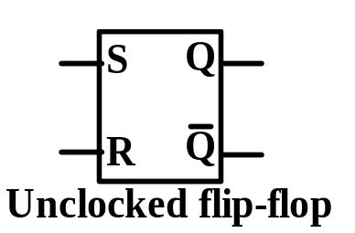
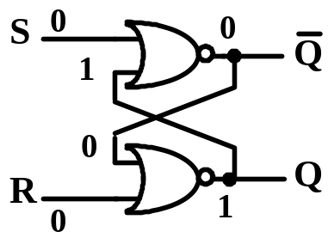
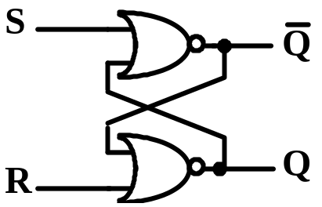
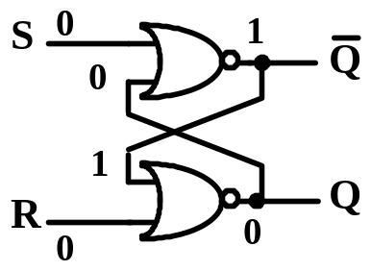
FLIP-FLOP AS
BASIC MEMORY UNIT
A simple SR Latch with two stable states:
Q=0, Q=1 in ‘0’ state; Q=1,Q=0 in ‘1’ state.
S(set), R(reset) — excitation signals.
Conceptual circuit:
symbol, state transition table
->1
S R 0 0
0 0 0 1 0 1 1 0 1 0 1 1 1 1
Q(t) 0 1 0 1 0 1 0
1
Q(t+1) 0 1 0 0 1 1
not defined
not defined
->0
} Q(t+1)=Q(t)
->1
->1
->0
} Q(t+1)=0
->1
->0
} Q(t+1)=1
->1
->0
->1

Slide 2
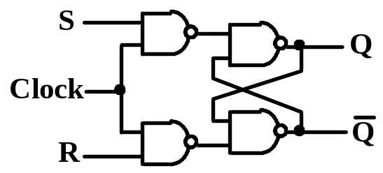
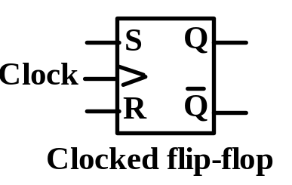
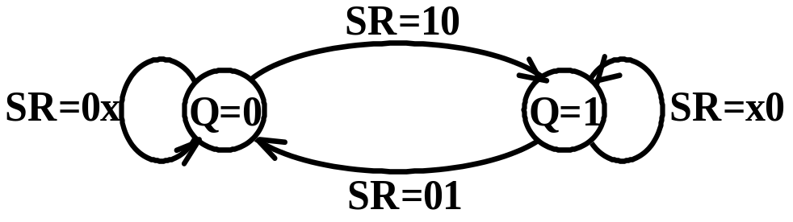
BASIC MEMORY UNIT: FLIP-FLOP
Clocked SR flip-flop
Flip-flop changes state only when clock = 1.
Conceptual ckt, symbol, state transition table
& equation:
S R 0 0
0 0 0 1 0 1 1 0 1 0 1 1 1 1
Q(t) 0 1 0 1 0 1 0
1
Q(t+1)
0
1
0
0
1
1
not defined
not defined
} Q(t+1)=Q(t)
} Q(t+1)=0
} Q(t+1)=1
Q(t+1) = S+RQ(t)
SR = 0 (restriction)
State transition diagram & excitation table:
Q(t)
0
0
1
1
Q(t+1)
0
1
0
1
S R 0 x
1 0 0 1 x 0

Slide 3
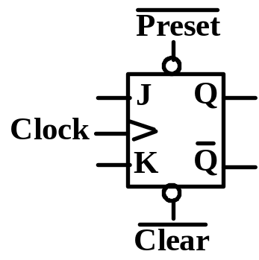
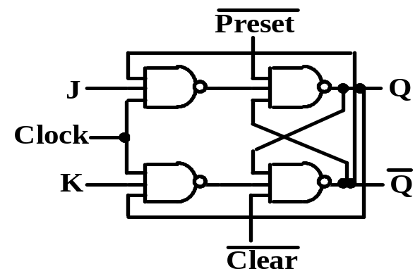
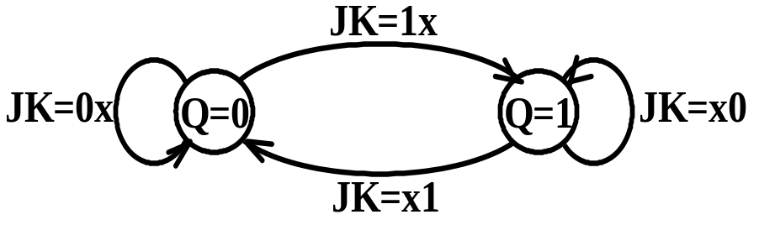
Clocked JK flip-flop
Extension of SR FF by allowing J=1 & K=1.
Conceptual ckt, symbol, state transition table & equation:
J K 0 0
0 0 0 1 0 1 1 0 1 0 1 1 1 1
Q(t) 0 1 0 1 0 1 0
1
Q(t+1)
0
1
0
0
1
1
1
0
} Q(t+1)=Q(t)
} Q(t+1)=0
} Q(t+1)=1
} Q(t+1)=Q(t)
Q(t+1) = JQ(t)+KQ(t)
State transition diagram & excitation table:
Q(t) 0 0 1 1
Q(t+1) 0 1 0 1
J K 0 x
1 x x 1 x 0

Slide 4
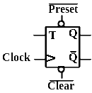
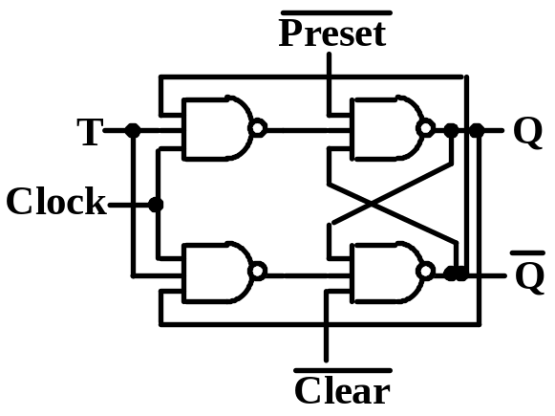
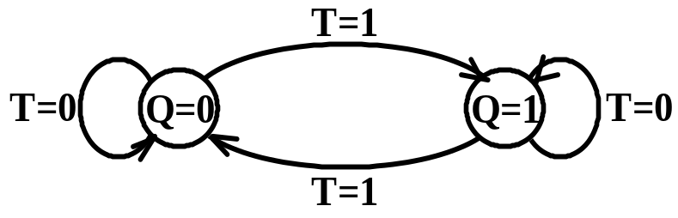
Clocked T flip-flop
A special case of JK FF by setting J=K=T.
Conceptual ckt, symbol, state transition table & equation:
T 0
0 1 1
Q(t) 0 1 0 1
Q(t+1) 0
1 1 0
} Q(t+1)=Q(t)
} Q(t+1)=Q(t)
Q(t+1) = TQ(t)+TQ(t)=T + Q(t)
State transition diagram & excitation table:
Q(t) 0 0 1 1
Q(t+1) 0 1 0
1
T 0
1 1 0

Slide 5
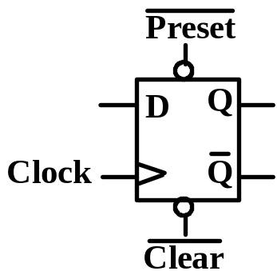
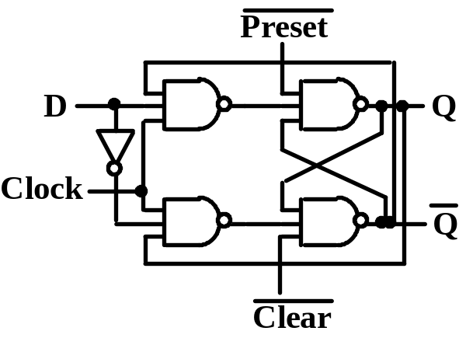
Clocked D flip-flop
A special case of JK FF by setting J=K=D.
Conceptual ckt, symbol, state transition table & equation
D 0
0 1 1
Q(t) 0 1 0 1
Q(t+1) 0
0 1 1
} Q(t+1)=D
Q(t+1) = D
State transition diagram & excitation table:
D=1
Q(t) 0
0
1
1
Q(t+1) 0 1 0 1
D0
1 0 1
D=0
Q=0
Q=1
D=1
D=0

Slide 6
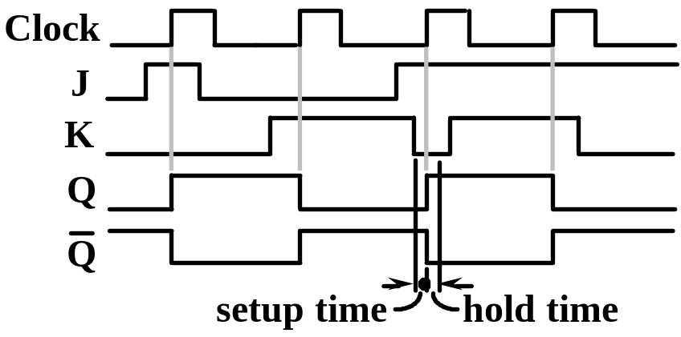
FLIP-FLOP AS BASIC MEMORY UNIT
Edge-triggered flip-flop
FF changes state only at the edge of the clock.
Solves the problem of multiple triggering of
level-controlled FF when level is active.
Two methods of circuit implementation:
◊ master-slave flip-flop
◊ special circuit
Typical waveforms of edge-triggered JK FF:
In the setup time, J,K must
be constant prior to the
active edge of the clock.
In the hold time, J,K must
not change after the
active edge of the clock.

Slide 7
FLIP-FLOP AS BASIC MEMORY UNIT
Master-Slave flip-flop
Master FF can change state only by CP = 1,
just like a level-controlled FF.
Slave FF is driven by master FF by CP=1,
independent of any changes of J and K.
Analysis of
the circuit
see Figure
4.18.
J
P
Q
CP
CP
P
K
Q
The master-slave
FF acts like a
negative edge- triggered FF.
CP
J
K
P
Q

